Slide 1
Survivorship: The “New” Normal
Presented by: Danielle Hamilton, RN, Oncology Certified Nurse Hematology/Oncology
Chelsea Myers, LCSW
Kaiser Permanente San Diego

Slide 2
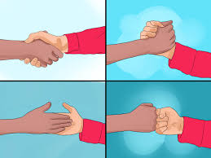
Introductions
Who are we
Who are you
What do you hope to gain from this class
Notes:
LCSW and RN

Slide 3
Today’s Agenda
What is Survivorship?
The “New” Normal
Medical Follow Up
Keeping a Treatment Summary/Survivorship Care Plan
A New Perspective on Your Health
Returning to Work and Leisure Activities
Taking Control of Finances and Logistics
Relationships with Yourself and Others
Notes:
LCSW-just read slide-this is what we’ll talk about

Slide 4
What is Survivorship?
“The process of living with, through and beyond cancer”
Three stages of survivorship:
Diagnosis and Treatment
Three months to one year –post treatment phase to active observation
Beyond a year during which frequency of care diminishes
Notes:
RN

Slide 5
What is the New Normal?
“The current state of being after some dramatic change has transpired. What replaces the expected, usual, typical state after an event occurs. The new normal encourages one to deal with current situations rather than lamenting what could have been.”
- The Urban Dictionary
Notes:
LCSW- Survivorship includes the physical, mental, emotional, social, and financial effects of cancer that begin at diagnosis and continue through treatment and beyond.
You might not want your old narrative-the way you think about things may have changed.

Slide 6
The “New” Normal
"It ain't over 'til it's over," but with cancer, you discover that it's not even over when it's over
When therapy stops, the effects don’t stop immediately
Treatment is over, but you may not be able to jump back into
your old routine
You may not WANT to!
And your regular medical team is not as constant by your side
Notes:
LCSW-Change in constancy of your treatment team and mental effort takes adjustment. Every day (or regularly) you have been doing something to eradicate cancer. This has become your routine, but now that changes.

Slide 7
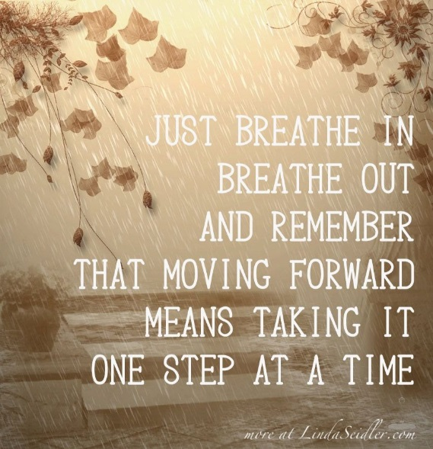
Adjusting to the “New” Normal
Manage your expectations
Decrease the stress and the pressure on you in whatever ways you can
There are a lot of decisions you can make to take charge of how your life goes while you're in this recovery process
Notes:
LCSW-Some people think you can jump back into life (friends and family may expect that). It takes time for your body to adjust to and process what has happened. Prioritize what’s important and manage your expectations around what you can accomplish daily. (Spoon theory)

Slide 8
MEDICAL FOLLOW UP - WHAT TO EXPECT
Who will be my doctor after treatment?
Oncologist
Surgeon
Dermatologist
Urologist
Gastroenterologist
Bone Marrow Transplant MD
Radiation Oncologist
Notes:
RN

Slide 9
MEDICAL FOLLOW UP - Recurrence
How likely is the cancer to return?
What is my schedule for F/U?
What testing do I need?
What are the benefits and risks of testing?
How do I lower the risk of recurrence?
What should I report right away and what can wait?
Notes:
RN

Slide 10
Fear of Recurrence
Any slight symptom can cause fear and stress
Scans (“Scanxiety”), anniversaries and follow up appointments can be triggers
Can lead to clinical depression or anxiety
You cannot directly control whether cancer returns, but you can control how much the fear affects your life! You fought hard to live…enjoy your existence!!!
Notes:
LCSW-Sore throat was just a cold before, but now you wonder “is it cancer?” Walking into the clinic for your next scan can bring up feelings/thoughts you had when you were there before. If it helps, bring someone with you. Find a meditation or podcast you can listen to while you’re waiting for your turn. Make a list of your questions to keep them all together in one place. Take care of things you do have control over.

Slide 11
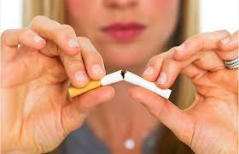
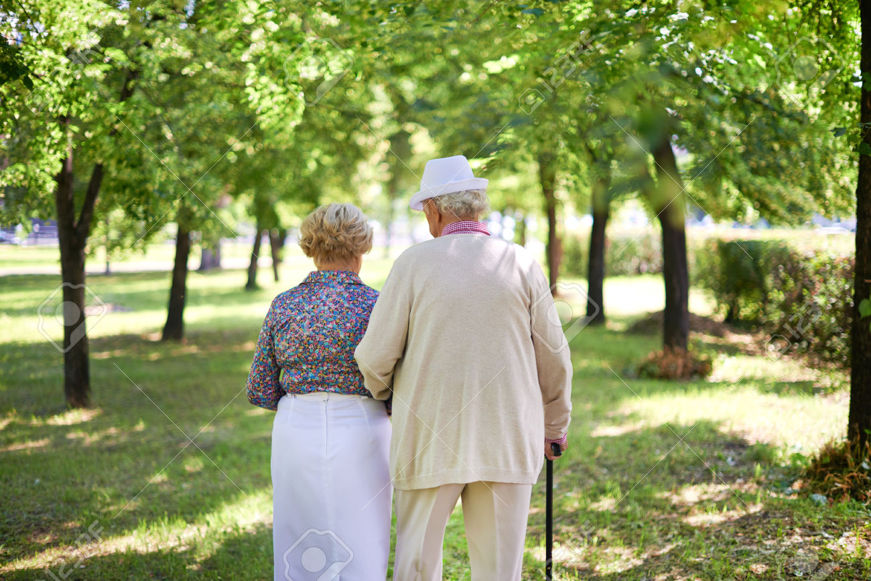
Coping with Fear of Recurrence
Talk with your health care team
Recognize your emotions
Take care of your physical and emotional health
Reduce stress
Notes:
LCSW-CALM and Headspace: https://healthy.kaiserpermanente.org/southern-california/health-wellness/mental-health/tools-resources/digital

Slide 12
Treatment Summary & Survivorship Care Plan
Background Information
Diagnosis
Treatment
Surgery
Radiation
Chemotherapy
Continuing Symptoms and Side Effects
Follow Up Care Plan
Keeping Track of Concerns
Notes:
RN

Slide 13
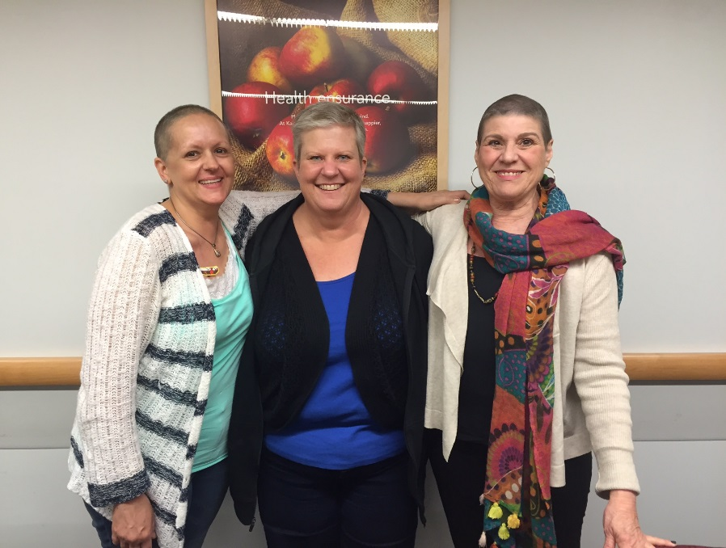
After Effects - HAIR
Regrowth
Texture
Hair thinning with medications
Notes:
RN

Slide 14
After Effects – SKIN
Cause – reduction in hormones, dehydration, inability of cells to renew, chemo, medications, and radiation.
First barrier against infection and outside invaders.
Skin care during and after chemo
Notes:
RN

Slide 15
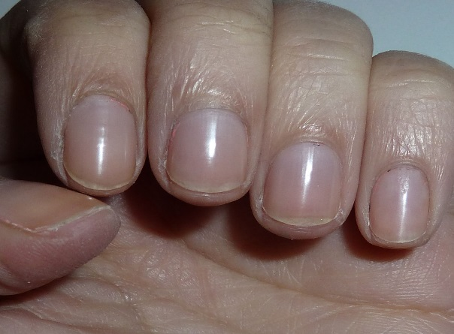
After Effects - NAILS
Nails may darken, peel, turn yellow, crack, become brittle.
Nails take longer than hair to recover – often over a year.
Some tips- keep cut short, do not use acrylics, keep cuticles hydrated with creams, wear gloves to do chores, don’t bite your nails.
Notes:
RN

Slide 16
After Effects – MUCOSAL AND DENTAL
Most common with head and neck cancers
Common issues are dry mouth, lack of saliva, mouth sores, inflamed gums, taste changes.
Most resolve within weeks to months of stopping treatment
Regular visits to dentist
Notes:
RN

Slide 17
After Effects - GI
Nausea and vomiting – Managed with with newer medications. If continues after treatment may be caused by exposure to smells or places where chemo was given.
If persists seek medical attention.
Diarrhea and constipation – usually resolve after treatment. Longer with GI cancers.
Notes:
RN

Slide 18
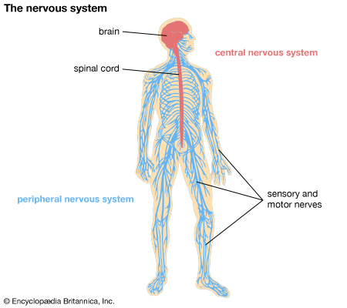
LONG TERM SIDE EFFECTS - CIPN
CHEMOTHERAPY INDUCED PERIPHERAL NEUROPATHY
Notes:
RN

Slide 19
Long term side effect - CIPN
Symptoms:
Numbness, Tingling, prickly sensations, weakness, sharp pain,
Affects fingers, toes, hands, feet, and arms and legs
Treatments:
Acupuncture OTC analgesics
Anticonvulsants Narcotics
Antidepressants OT and PT
Splints Biofeedback
Notes:
RN

Slide 20
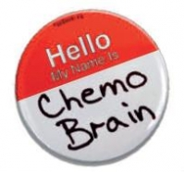
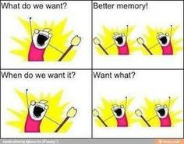
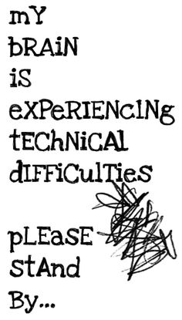
After effect - Chemo Brain/Cancer Fog
Notes:
LCSW

Slide 21
Chemo Brain
A catchall term for the cognitive dysfunction and neurophysiological changes produced by chemotherapy toxicity
This is an important quality-of-life issue for cancer survivors
Notes:
LCSW-Technical name is: Cancer Related Cognitive Impairment (CRCI).

Slide 22
AFTER EFFECT CHEMO BRAIN
POSSIBLE NON-CHEMO CAUSES
The cancer itself
Other drugs – steroids, anti-nausea, pain medications
Low blood counts
Sleep problems
Depressions
Anxiety, stress, worry, other emotional pressure
Infection
Fatigue
Hormone changes
Nutritional deficiencies
Notes:
LCSW-Chemo kills the good and the bad cells so it takes time for your body to work it through. Most effects will go away – the others you can learn to manage.

Slide 23
Symptoms of Chemo Brain
Memory, concentration, attention
Word retrieval
Multitasking, affecting competence at home and at work
Spatial orientation (poor sense of direction)
Difficulty following the thread of conversations and fearing others will notice
Compounding depression or fatigue
“Task completion is where I am most affected cognitively. It’s as if the follow-through feature has been removed from my brain.”
“I would struggle with spelling words I had known forever. I would forget names, places, and conversations.”
Notes:
LCSW

Slide 24
Coping Strategies – Chemo Brain
Make lists
Use a daily planner
Keep a memory notebook
Leave yourself messages
Organize your environment
Avoid distractions
Have conversations in quiet places
Repeat information out aloud after someone gives it to you and write it down
Keep your mind active
Proofread
Train yourself to focus
Exercise, eat well, get plenty of rest and sleep
Tell your family and friends and ask for their help!
Notes:
LCSW-For a full class please see: https://www.eventcombo.com/ms/ev/75093/memory-and-attention-adaptation-training-for-chemo-brain-out/home?eventRoleId=
Be present, stop and take a mental picture of where you parked, or use your phone to take a picture, or say it outloud. Tell ppl what you’re experiencing – ppl want to help!

Slide 25
AFTER EFFECT - MENOPAUSE ANDROPAUSE
MENOPAUSE/ANDROPAUSE
CAUSES:
Surgery
Antiestrogen/ Testosterone medications
Chemotherapy
Aging
Notes:
RN-can skip next three slides of it doesn’t apply to anyone (no BRCA/no prostate CA)

Slide 26
AFTER EFFECT - MENOPAUSE
Symptoms:
Hot flashes Night sweats
Fatigue Vaginal dryness
Mood swings Irritability
Osteoporosis Depression
Sleep problems Weight gain
Hair loss Fuzzy thinking
Bladder issues Sexual dysfunction
Notes:
RN

Slide 27
AFTER EFFECT - ANDROPAUSE
Low sex drive
Difficulties getting erections or erections that are weaker than usual
Lack of energy
Depression
Irritability and mood swings
Loss of strength or muscle mass
Increased body fat
Hot flashes
Notes:
RN

Slide 28
Coping with & treating sexual challenges
Less interest in sex is normal during times of crisis
Treatments, even those not focused on pelvic area or groin can interfere with sexual function
How you feel about your body impacts sexuality
Important to discuss with health care team and partner
Treatment options exist
Flexibility and openness is key!
Notes:
LCSW-Be flexible, communicate. Recognize that the body is different, not bad. Try to observe or be curious rather than judgmental. This is who you are now because you LIVED. Cancer forces you to shift from what you look like to who you are.

Slide 29
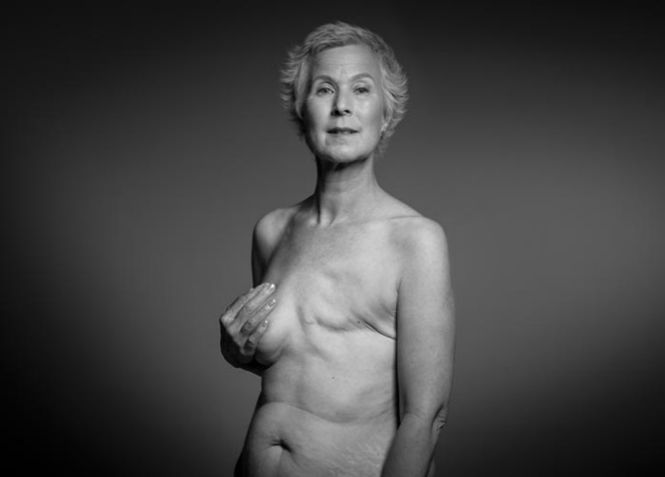
Body Image and Self-Esteem
Body image is really about self-acceptance and self-care
Cancer and treatment can affect our physical appearance and how we feel about ourselves inside and out
Everyone is different and people have varying areas of focus (“unicorn”, loss of testicle, colostomy, hair loss, scars)
Notes:
LCSW

Slide 30
Body Image and Self-Esteem
Grief Recognition Acceptance
Cancer forces a shift from:
What I look like
Who I am
Notes:
LCSW

Slide 31
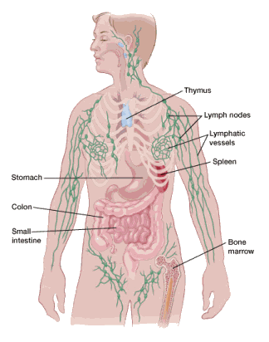
Long Term Side Effect
LYMPHEDEMA – definition
CAUSES:
SURGERY
TUMOR BLOCKAGE
INFECTION
RADIATION
MANAGEMENT:
Physical Therapy Consultation
Compression Devices
Massage/Manual lymph drainage
Exercise Therapy
Meticulous skin and nail care
Notes:
RN

Slide 32
LONG TERM CONSEQUENCES OF TREATMENT
HEART AND LUNG
Higher risk for people who already had medical problems
Some chemo affects heart and lung
Doctor will order tests when needed, usually MUGA
Will be referred to Cardiology or Pulmonary if indicated
Notes:
RN

Slide 33
“I am so tired!!”
Notes:
LCSW

Slide 34
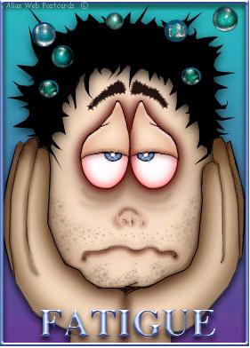
FATIGUE
Definition-
A daily lack of energy; unusual or excessive whole-body tiredness, not relieved by sleep. Often described as “PARALYZING”.
Comes on suddenly not related to exertion or activity.
Notes:
RN

Slide 35
FATIGUE - CAUSES
Medications to treat nausea and manage pain
The build-up of toxic substances that are left in your body after cells are killed by cancer
Injury to normal cells
Fever or infection
Dehydration
Loss of appetite or not getting enough calories and nutrients
Trouble sleeping
Anemia (low level of red blood cells).
Shortness of breath
Anxiety, depression, stress, grief
Notes:
RN

Slide 36
FATIGUE - HOW TO MANAGE
Conserve energy for must do tasks
Manage depression, anxiety, stress
Mindfulness
Manage medical causes – anemia, pain
Eat well – Drink water
Exercise – mild to moderate exercise
Ask for help to conserve energy
Escape with distraction and interaction
Ask your medical team for help
Medications
Notes:
RN

Slide 37
Anxiety and Depression
Most people face some degree of depression, anxiety, and fear when cancer becomes part of their lives
Up to 1 in 4 people with cancer have clinical depression
Some Risk Factors:
Family History (substance abuse, mental illness, suicide)
Lack of Support System
Loss of Control Over One’s Own Life
Sleep Deprivation
Hormone Imbalance
Medication Side Effects
Uncontrollable Pain
Advanced Cancer
Stress from Other Life Events
Notes:
LCSW-Some sx are depression and some are anxiety and some are both.

Slide 38
Treating Anxiety or Depression
Kaiser Permanente Psychiatry Self Referral 877-496-0450
Oncology Clinical Social Worker Short Term Counseling 619-528-3152
Support Groups
Mind Over Cancer Mindfulness Course
Exercise, Yoga, Meditation
Notes:
LCSW-Slides sent out has wrong number for OPP (was internal med #). Exercise is the only proven way to increase energy lost as a result of chemotherapy. For some people, walking is just as effective as an antidepressant.

Slide 39
Managing Sleep
Establish a consistent bedtime routine.
Take a warm bath, go for a relaxing stroll, or practice meditation/relaxation exercises as part of your regular nighttime routine.
Try to go to bed at the same time every night, and get up at the same time each morning. This includes weekends.
Get plenty of exercise during the day. People who are physically active sleep better than those who are sedentary.
Reduce your intake of caffeine and alcohol, particularly in the evening.
Avoid large meals late in the evening.
Notes:
LCSW-Fatigue is not about tiredness. Cancer related fatigue may not go away with rest like it did before. It can be discouraging. It’s not uncommon to lack the stamina to work a full day like you did before. Prepare your body as best as you can by practicing good sleep hygiene.

Slide 40
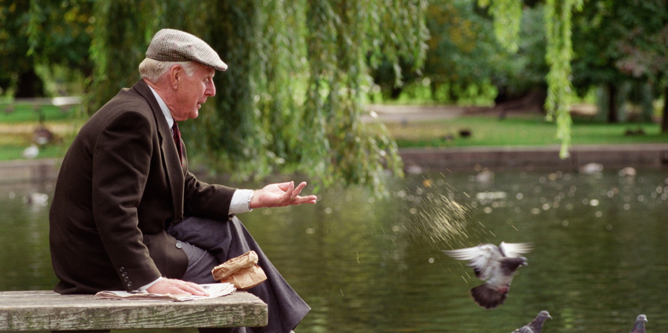
Managing Sleep
Learn and use a relaxation technique regularly like breathing exercises, meditation, and yoga.
Use "white noise" devices to block out surrounding environmental noise.
Don't obsess about not sleeping. Individuals who worry about falling asleep have greater trouble dropping off.
Short naps are good. Try to get into the habit of napping: 10 to 20 minutes in the afternoon, preferably lying down in a darkened room.
Spend some time outdoors as often as you can to get exposure to bright, natural light - 30 minutes each morning is preferable.
Spend up to an hour in dim light before bed. Lower the lighting in your house and bedroom. If other members of the household object, wear sunglasses.
Do not turn on a bright light if you get up in the middle of the night.
Notes:
LCSW-Dr. Huberman (a neuroscientist) has this: https://www.hubermanlab.com/newsletter/toolkit-for-sleep

Slide 41
STAY HEALTHY
Tobacco Cessation
Limit or stop alcohol use
Eat well and maintain a health weight
Stay hydrated
Protect yourself from the sun
Exercise
Follow up with your medical team
Notes:
RN

Slide 42
Returning to Work and Leisure Activities
Performance Status
Comorbidities
Preparing and Planning Your Return
Talking with Colleagues
New Work/Life Balances
Finding New Hobbies and Interests
Seek Volunteer Opportunities
Notes:
LCSW-Plan ahead how to respond to coworkers who ask, “Where have you been?” How much do you want to disclose? You may want to refrain from social activities at work for a while.

Slide 43
Managing Finances and Logistics
Financial Stress
Financial Assistance Resources
Creditors
Insurance
Disability
Advance Directives
Notes:
LCSW-Cancer can cause a financial burden. Let creditors know you have cancer – everyone knows someone touched by cancer.

Slide 44
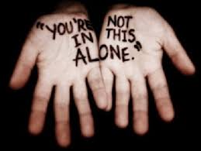
Relationships After Treatment
Spouse/Partner
Dating
Adult Children
Younger Children
Friends who were there
Friends who weren’t
Colleagues
Acquaintances
Notes:
LCSW – Role changes (children have taken on parent role and it may take time to reclaim), consider forgiveness of those who weren’t there or disappeared from your life after hearing you had cancer.

Slide 45
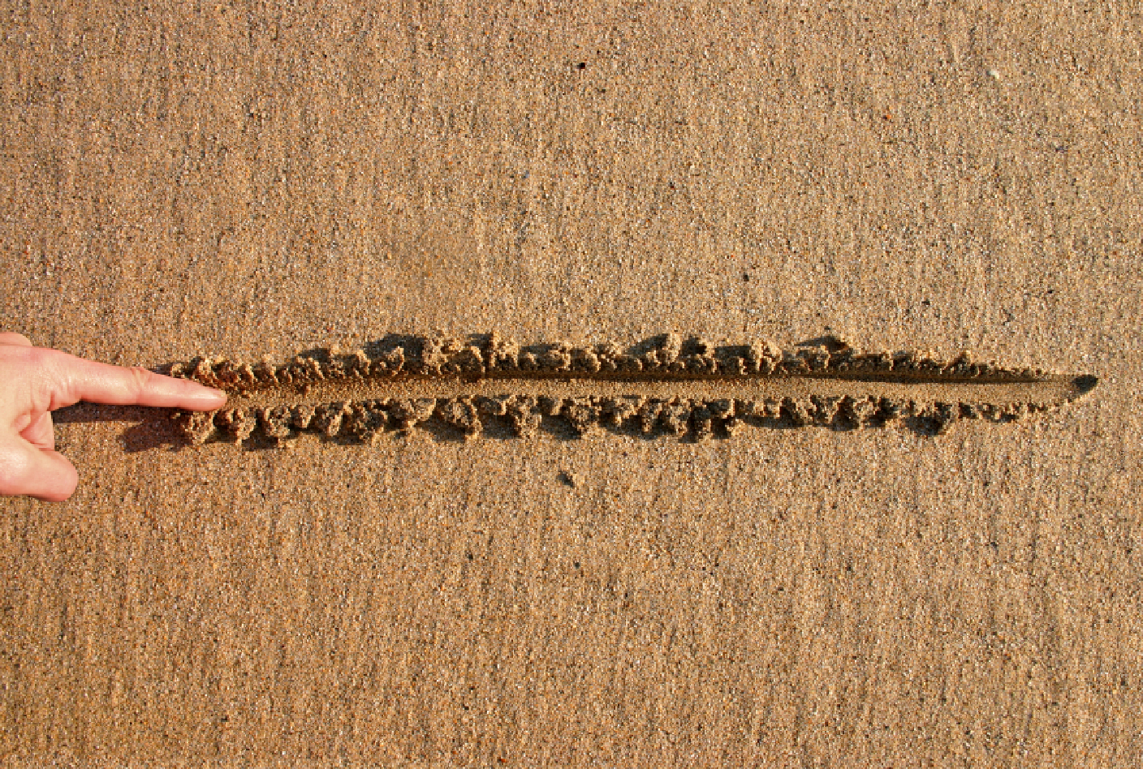
Healthy Boundaries
You have a right to personal boundaries
Recognize that other people's needs and feelings are not more important than your own
Learn to say no!
Identify the actions and behaviors that you find unacceptable
Trust, believe in, and be patient with yourself
Notes:
LCSW-you have the right to say no. You can tell people, “I just can’t hear a story about your friend or family member who had cancer right now.”

Slide 46
Tips for Taking Care of Yourself
Identify your limits
Tune into your feelings
Practice staying in the moment
Make self-care a priority
Give yourself permission
Be honest and direct
Seek support
Take baby steps and applaud each success!
Notes:
LCSW

Slide 47
The End
Notes:
LCSW/RN

